Slide 1
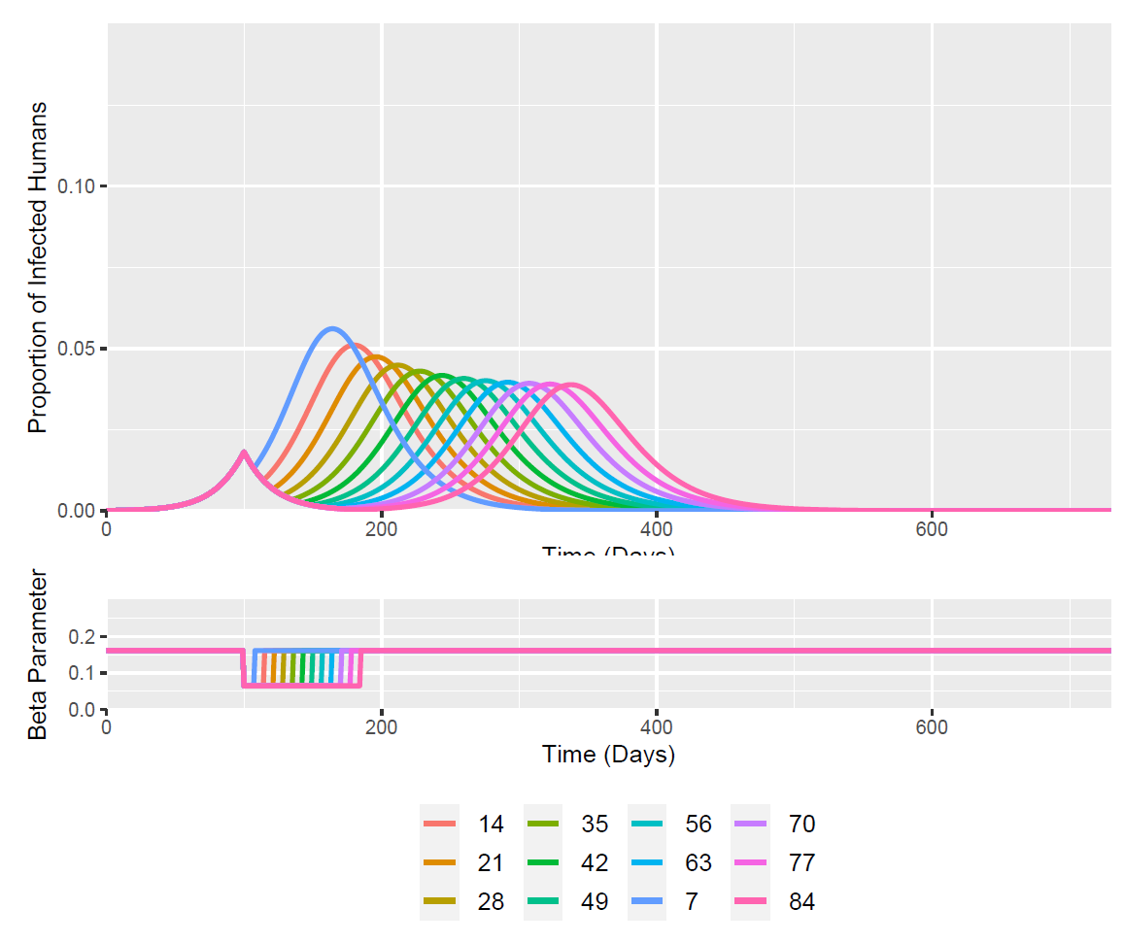
Time of Intervention = 100 Days (optimised for 2 intervention scenario)
I(t = 100 days) = 0.0181504276

Slide 2
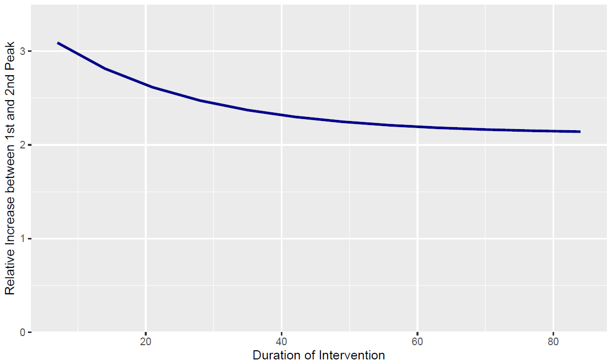
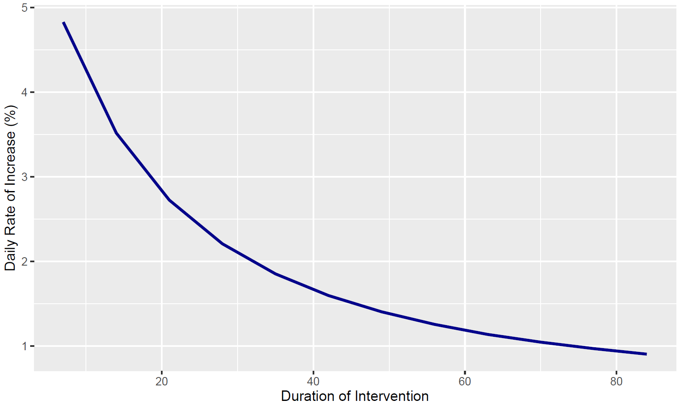
I(t = 100 days) – 1st Peak
I(t) = 0.0182
Week Duration | I(t) Second Peak | Relative Increase Between Peaks | Days Between Peaks | Daily % Increase to Reach Second Peak
1 Week | 0.056 | 3.091 | 64 | 4.829
2 Week | 0.051 | 2.814 | 80 | 3.517
3 Week | 0.047 | 2.615 | 96 | 2.724
4 Weeks | 0.045 | 2.473 | 112 | 2.208
5 Weeks | 0.043 | 2.371 | 128 | 1.852
6 Weeks | 0.042 | 2.298 | 144 | 1.596
7 Weeks | 0.041 | 2.246 | 160 | 1.404
8 Weeks | 0.040 | 2.209 | 176 | 1.255
9 Weeks | 0.040 | 2.182 | 192 | 1.137
10 Weeks | 0.039 | 2.164 | 207 | 1.045
11 Weeks | 0.039 | 2.151 | 222 | 0.969
12 Weeks | 0.039 | 2.141 | 237 | 0.903

